Slide 1
Lecture 3; Direct and indirect control in Electro-pneumatic

Slide 2
Presentation outline
Electro-pneumatic basic control components
Electro-pneumatics Signal control system
Solenoid valves
Direct control in Electro-pneumatics
Indirect control in Electro-pneumatics

Slide 3
Electro-pneumatic Basic Control Components
The electro pneumatic system is normally consists of the
following items: 1. DC power supply
2. Switches
3. Relays/PLC
4. Solenoid valves 5. Sensor

Slide 4
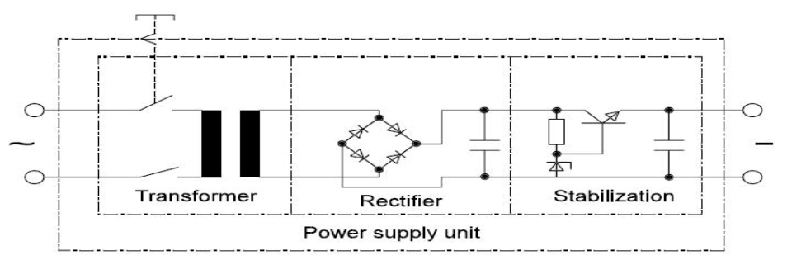
Electro-pneumatics Basic Control Components
1. DC power supply
The power supply is used to reduce and convert the 230 V AC to a 24 V DC
The power supply components have the following functions:
The transformer reduces the main voltage (230 to 24 volt).
The rectifier converts the AC voltage to DC voltage.
The stabilizer is used to smooth and maintain constant voltage at the output

Slide 5
Electro-pneumatic Basic Control Components
2. Switches
Switches are installed in an electric circuit to connect or interrupt the
electric current.
A push button is a switch used to close or open an electric control circuit.
They are primarily used for starting and stopping of operation of machinery.
Push button switches are actuated by pushing the actuator into the housing, this
causes set of contacts to open or close.
Push buttons are of two types
i) Momentary push button
ii) Maintained contact or detent push button

Slide 6
Electro-pneumatic Basic Control Components
2. Switches
Momentary push buttons return to their unactuated position when they
are released.
Maintained (or mechanically latched) push buttons has a latching
mechanism to hold it in the selected position.
It is also called detent switch or a latching switch
The contact of the push buttons, distinguished according to their
functions,
i) Normally open (NO) type
ii) Normally closed (NC) type
iii) Change over (CO) type

Slide 7
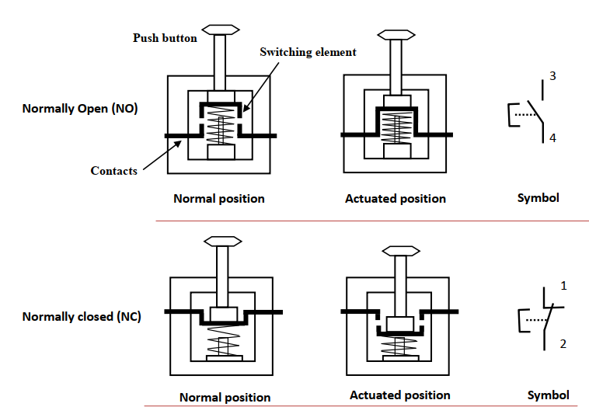
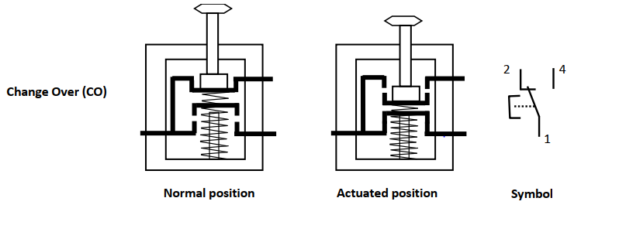

Slide 8
Electro-pneumatic Basic Control Components
3. Relays
A relay is an electro-magnetically actuated switch.
It is a simple electrical device used for signal processing. When a voltage is applied to the solenoid coil, an electromagnet field results.
This causes the armature to be attracted to the coil core.
The armature actuates the relay contacts, either closing or opening them, depending on the design.
A return spring returns the armature to its initial position when the current to the coil is interrupted

Slide 9
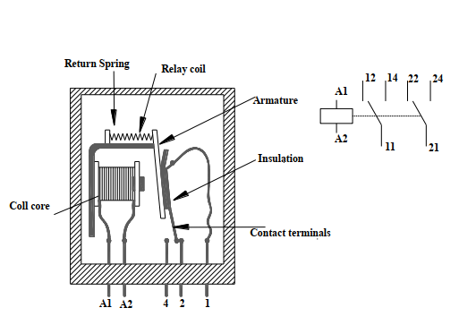

Slide 10
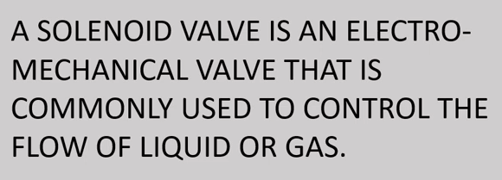
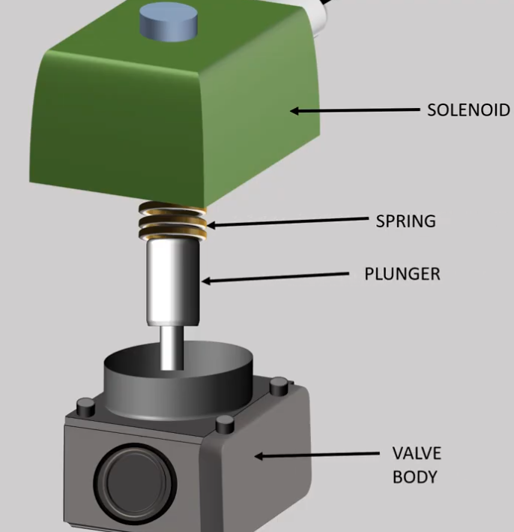
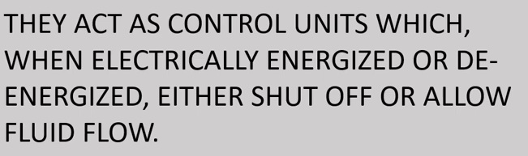
Electro-pneumatic Basic Control Components
4. Solenoid valves

Slide 11
Electro-pneumatic Basic Control Components
4. Solenoid valves
Electrically actuated directional control valves form the interface between the two parts of an electro-pneumatic control.
The most important tasks of electrically actuated DCVs include. i) Switching supply air on or off ii) Extension and retraction of cylinder drives

Slide 12
Electro-pneumatic Basic Control Components
4. Solenoid valves Cont..
Electrically actuated directional control valves are switched with the aid of solenoids.
They can be divided into two groups i) Spring return valves only remain in the actuated position as long as current flows through the solenoid
ii) Double solenoid valves retain the last switched position even when no current flows through the solenoid.

Slide 13
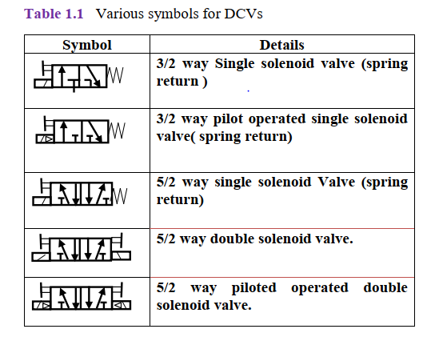

Slide 14
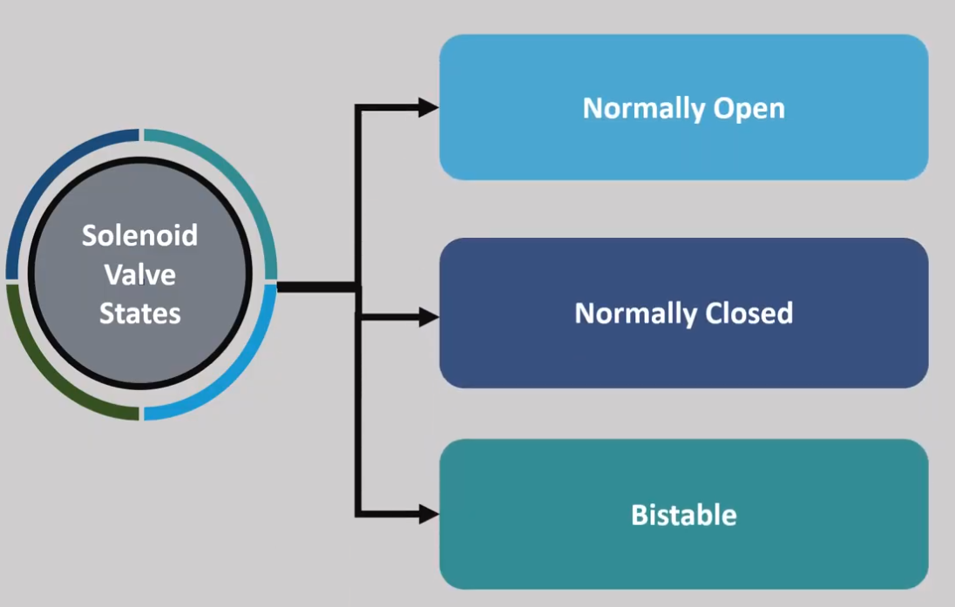

Slide 15
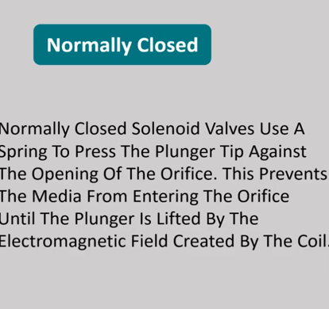
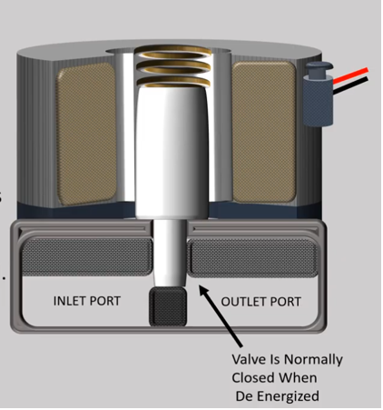

Slide 16
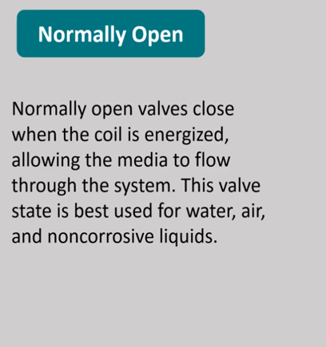
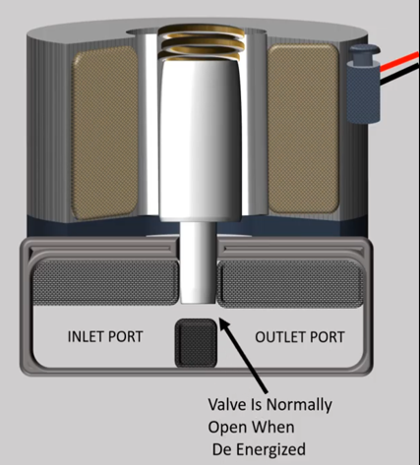

Slide 17
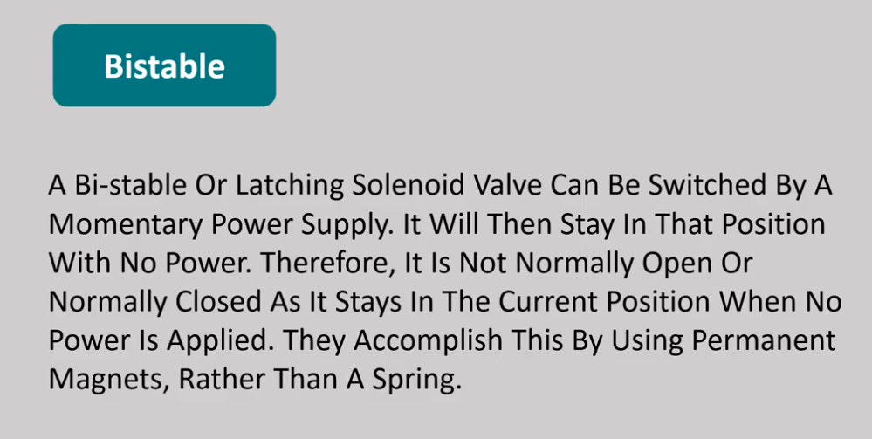

Slide 18
Electro-pneumatic Basic Control Components
4. Solenoid valves Cont..
Types of Solenoid valves
Based on working principles
Direct-acting Solenoid Valve
Pilot-operated Solenoid Valve (indirect acting/servo solenoid valve)

Slide 19
Electro-pneumatic Basic Control Components
4. Solenoid valves Cont..
Types of Solenoid valves
Based on the number of pipe connections
Two-way Solenoid Valve
Three-way Solenoid Valve
Four-way Solenoid Valve

Slide 20
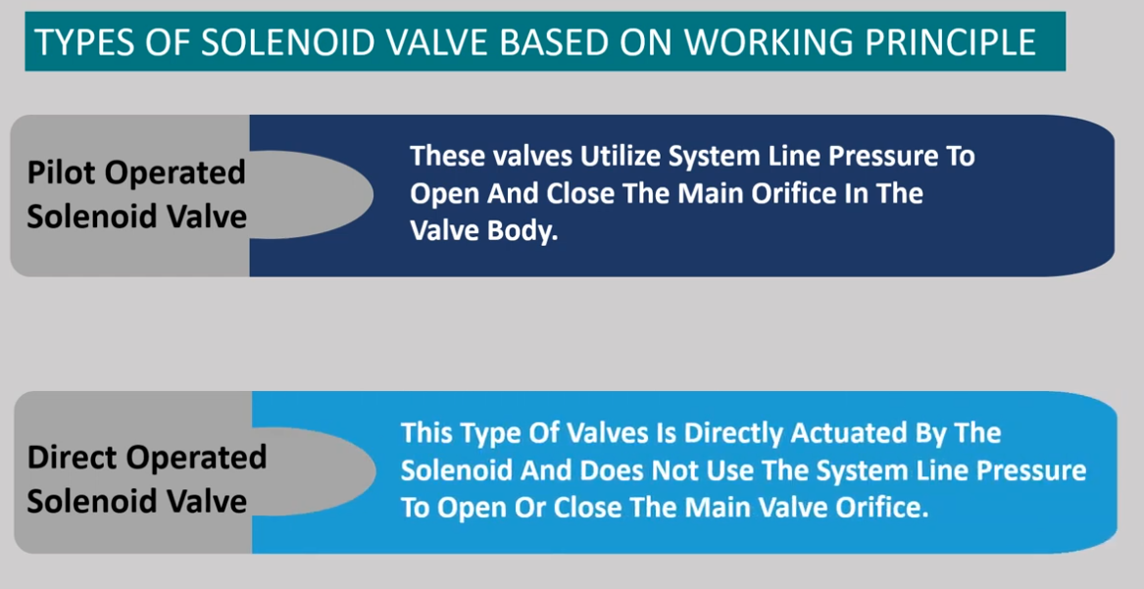

Slide 21
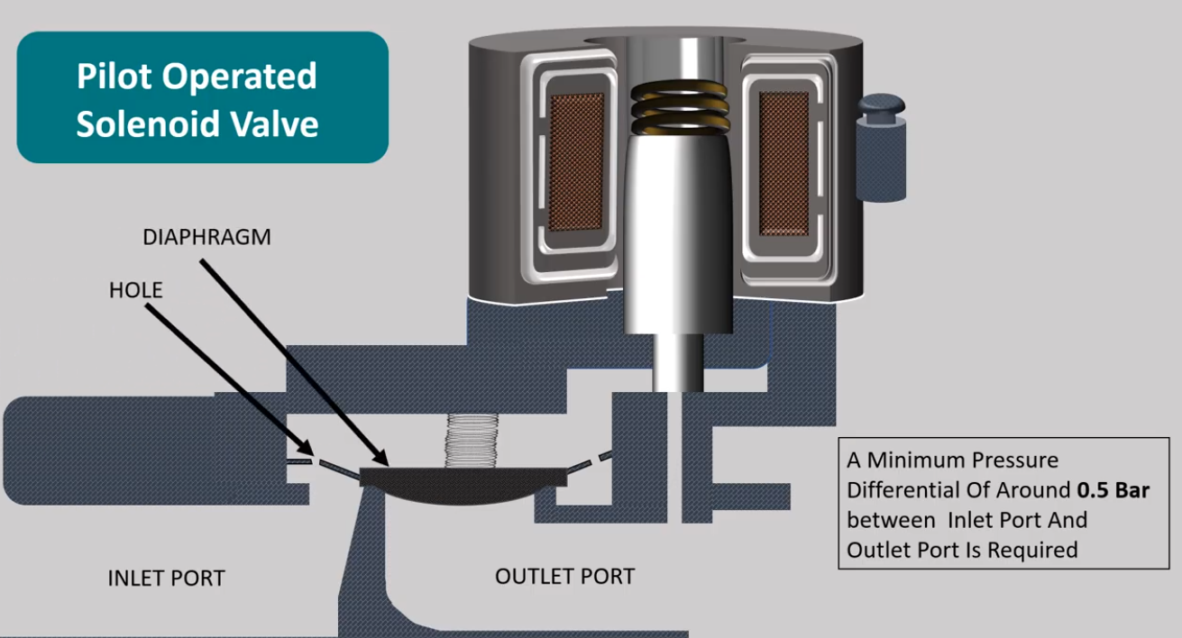

Slide 22
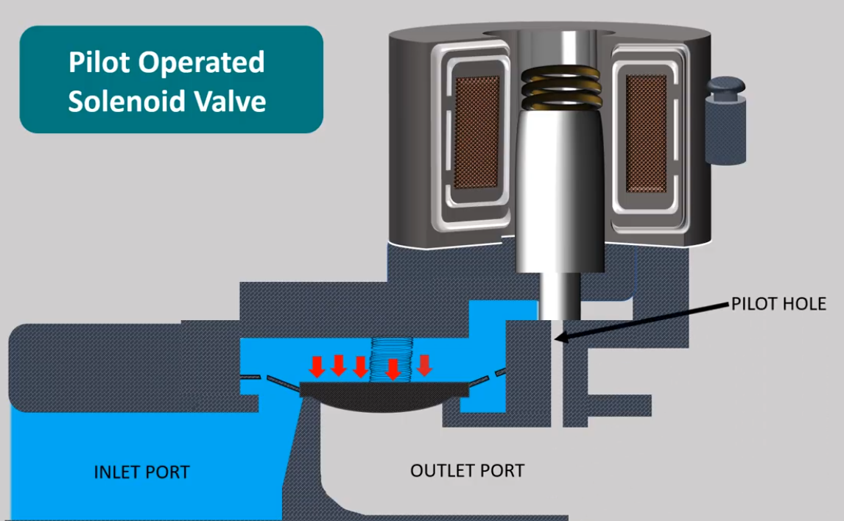

Slide 23
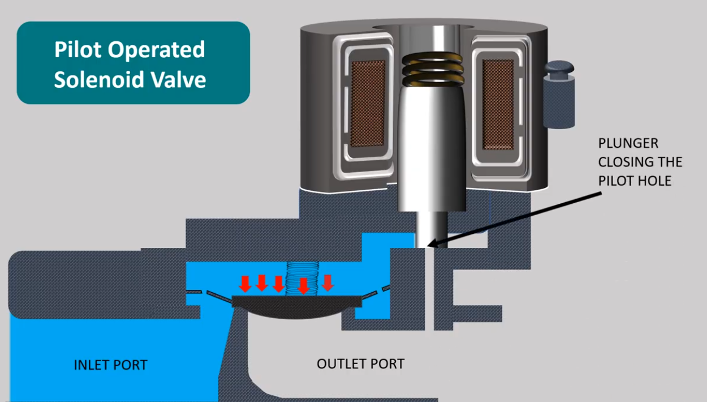

Slide 24
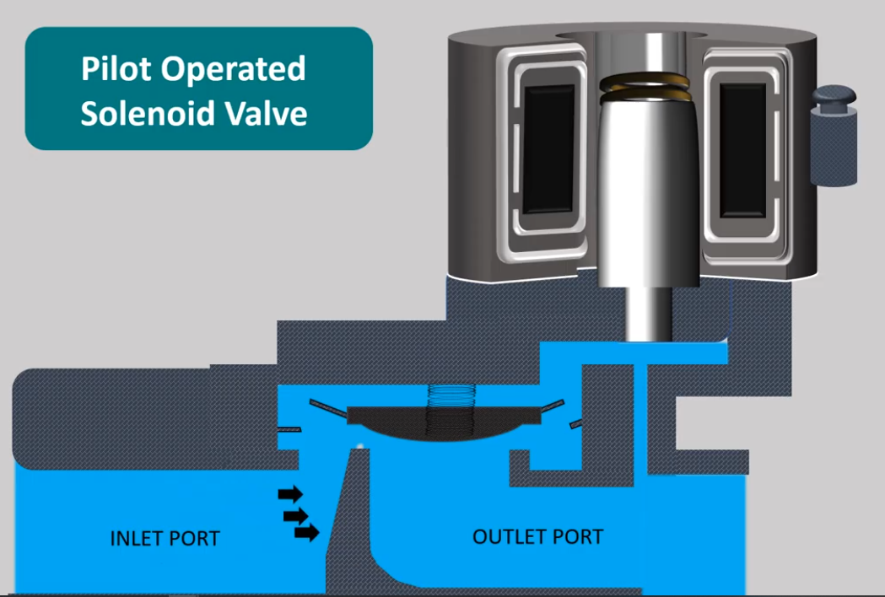

Slide 25
Electro-pneumatic Basic Control Components
5. Sensor
Sensors have the task of measuring information and passing this on to the signal processing unit of the control system in a form that can easily be processed.
In electro-pneumatics controlling systems, sensors are primarily used for the following purposes:
To detect the advanced and retracted end position of the piston rod in cylinder drives.
To detect the presence and position of work piece.
To measure and monitor pressure.

Slide 26
Electro-pneumatic Basic Control Components
5. Sensor cont..
The following sensors are widely used in the industry:
1. Limit switch
2. Proximity switches
3. Pressure switches

Slide 27
Electro-pneumatic Basic Control Components
Limit switches
limit switch is a switch that is actuated due to the position of a fluid power
component (usually a piston rod or hydraulic motor shaft or the position of load)
The actuation of a limit switch provides an electrical signal that causes an
appropriate system response.
Limit switches perform the same function as push button switches.
Push buttons are manually actuated whereas limit switches are mechanically
actuated
The limit switch can be used in circuit according to one of the following:
❖ Normally open switch
❖ Normally closed switch
❖ Changeover switch

Slide 28
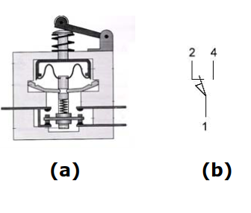
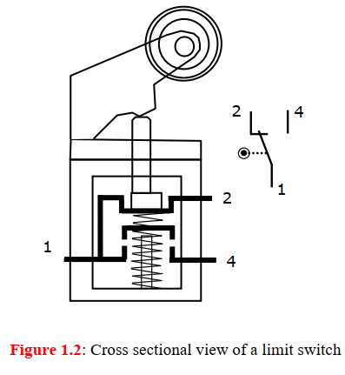

Slide 29
Electro-pneumatic Basic Control Components
2. Proximity switches
A proximity sensor is a device that can detect or sense the approach or presence of nearby objects and for this it does not need physical contact.
There are different kinds of proximity sensors. Some of them are.
a. Reed switch
b. Inductive proximity switch
c. Capacitive proximity switch
d. Optical proximity switch witches

Slide 30
Electro-pneumatic Basic Control Components
3. Pressure switches A pressure switch is a pneumatic-electric signal converter.
Pressure switches are used to sense a change in pressure, and opens or closes an electrical switch when a predetermined pressure is reached. Bellow or diaphragm is used to sense the change of pressure and expand or contract in response to increase or decrease of pressure.
When the pressure is applied at the inlet and when the pre-set pressure is reached, the diaphragm expands and pushes the spring loaded plunger to make/break contact.

Slide 31
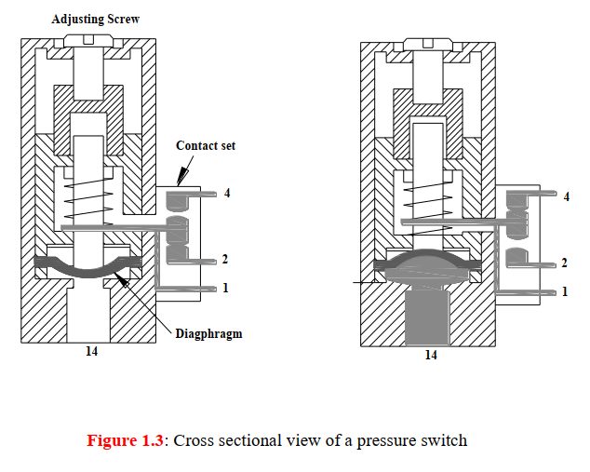

Slide 32
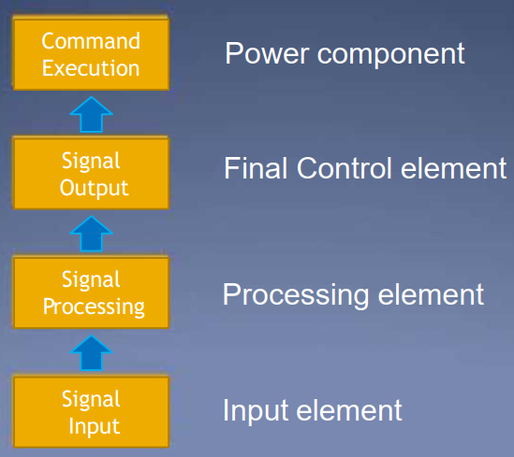
Electro-pneumatic Signal Control System

Slide 33
Electro-pneumatic Signal Control System
Signal flow within an electro-pneumatic system is as follows. 1. Signal input: This signal is usually generated from sensor or switch. 2. Signal processing: The signal is processed in the processing station such as relay, contactors, PLC 3. Signal output: The signal forms as a link between the signal control section and the power section. Solenoid-DCV 4. Command execution: It takes place at high power level either for:Pneumatic Cylinders, motors

Slide 34
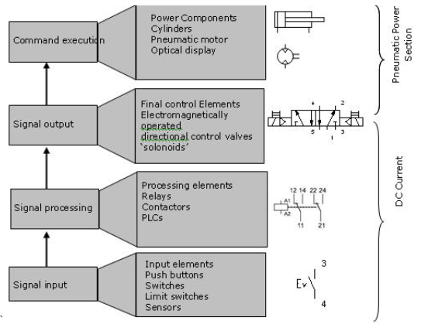
Electro-pneumatic Signal Control System

Slide 35
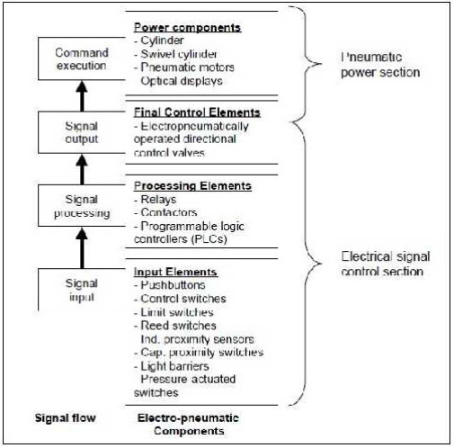
Electro-pneumatic Signal Control System

Slide 36
Direct Control in Electro-pneumatic
Direct control is the control of an electro-pneumatics valve without using intermediate components such as a relay, a contactor or an industrial computer(PLC). Advantages of direct control
Simple and easy
Cheap
Disadvantages of direct control
Remote control is not possible
Switching more than one valve at a time is not possible
Latching is not possible
Design improvement is not flexible

Slide 37
Direct Control in Electro-pneumatic
Direct Control of single acting cylinder Forward stroke
The circuit is closed when push button PB closes.
A magnetic field is produced in the coil Y.
The armature in the coil opens the passage for the compressed air.
The compressed airflows from 1 to 2 of the 3/2 DCV to cylinder, which travels 3/2
way the final forward position.
Return stroke
When the push button PB is released, the circuit is interrupted.
The magnetic field at coil Y collapses, the 3/2-way valve switches back to its original
position as shown in Figure below
The compressed air in the cylinder then exhausts through port 3 of the DCV and the cylinder travel to the final rear position.

Slide 38
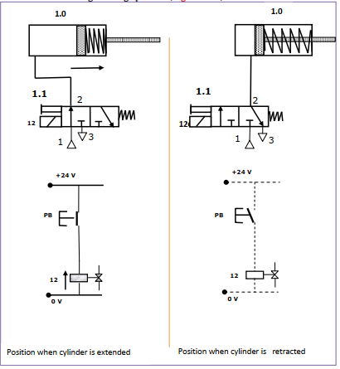

Slide 39
Direct Control in Electro-pneumatic
Direct Control of double acting cylinder Forward stroke
The double acting cylinder is controlled by 5/2-way valve.
When the pushbutton PB is pressed, coil Y is energized and the directional control valve is activated by compressed air via pilot control.
The piston travels to the final forward position.
Return stroke
When the push button PB is released, the circuit is interrupted.
The magnetic field at coil Y collapses, the return spring of 5/2 becomes active and the 5/2-way valve switches back to its original position as shown in Figure below.
The compressed air in the cylinder then exhausts through port 5 of the 5/2 DCV and the cylinder travel to the final rear position.

Slide 40
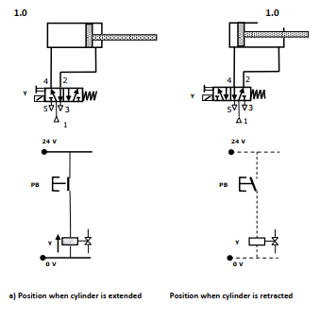

Slide 41
Indirect control in Electro-pneumatic
Indirect control is the control of an electro-pneumatic valve using intermediate components such as a relay, a contactor or any industrial computer (PLC). Advantages of indirect control systems
Remote control is possible
Switching more than one valve at a time is possible
Latching is possible
Flexible design improvement and development
Disadvantages of indirect control
Complicated, more wiring
More cost involved

Slide 42
Indirect control in Electro-pneumatic
Indirect Control of single acting cylinder Forward stroke
The circuit is closed when push button PB closes.
Closing of Push button PB energizes a relay K1.
The coil Y is energized via normally open contact K1 (indirect energizing). A magnetic field is produced in armature of the coil Y opens the passage for the compressed air.
The compressed air flows from 1 to 2 of the 3/2 DCV to cylinder, which travels to the final forward position. Return stroke
When the push button PB is released, the circuit is interrupted.
Opening of Push button PB de-energizes a relay K1.
The magnetic field at coil Y is collapses due to the opening of contact K1 the 3/2-way valve switches back to its original position as shown in Figure below.
The compressed air in the cylinder then exhausts through port 3 of the DCV and the cylinder travel to the final rear position

Slide 43
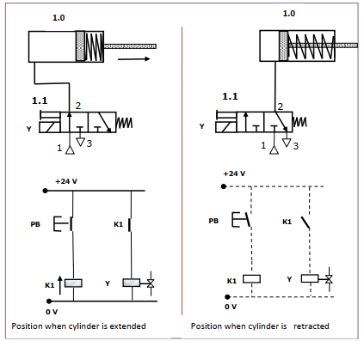

Slide 44
Indirect control in Electro-pneumatic
Indirect Control of double acting cylinder (using 5/2-way, single solenoid)
Forward stroke
The circuit is closed when push button PB closes. Closing of Push button PB energizes a relay K1.
The coil Y is energized via normally open contact K1 (indirect energizing).
A magnetic field is produced in armature of the coil Y opens the passage for the
compressed air through internal pilot.
The compressed air flows from 1 to 4 of the 5/2 DCV to cylinder, which travels to the final forward position.
Return stroke
When the push button PB is released, the circuit is interrupted.
Opening of Push button PB de-energizes a relay K1.
The magnetic field at coil Y is collapses due to the opening of contact K1 the 5/2-wayvalve switches back to its original position as shown in Figure below.
The compressed air in the cylinder then exhausts through port 5 of the DCV and the cylinder travel to the final rear position

Slide 45
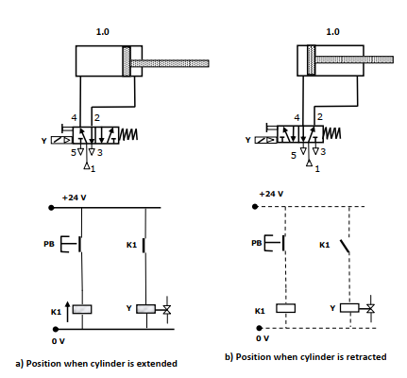

Slide 46
Indirect control in Electro-pneumatic
Indirect Control of double acting cylinder (using 5/2-way, double solenoid)
Forward stroke
When push button PB1 is pressed, coil Y1 is energized and 5/2 way directional control valve changes over.
The piston travels out and remains in the final forward position until a signal is applied to coil Y2.
The 5/2 directional control valve will remain in the last position because it is double solenoid valve and has no return spring. Return stroke
When the push button PB1 is released and PB2 is pressed.
Opening of Push button PB1 de-energizes a relay K1.
The magnetic field at coil Y1 is collapses due to the opening of contact K1.
Closing of PB2 energizes Y2 and the piston returns to its original position as a result of changeover of the 5/2-way valve.
The 5/2 way directional control valve will not switch over if there is an active opposing signal.
For example, if Y1 is switched on and a signal is given to Y2, there will be no reaction as there would be an opposing signal

Slide 47
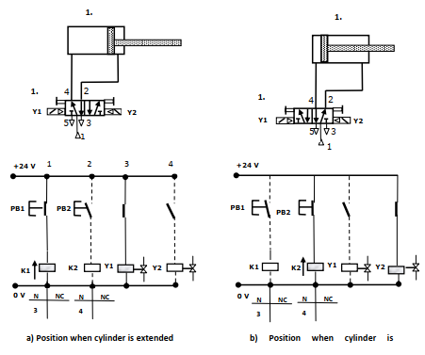

Slide 48
Assignment
Describe how relay works

